Slide 1
Designing and Analysis of Algorithms Course Code: ECS 5101/CS514
Dr Rahul Mishra
IIT Patna
Lecture 10

Slide 2
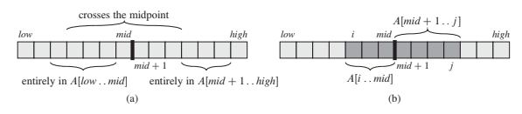
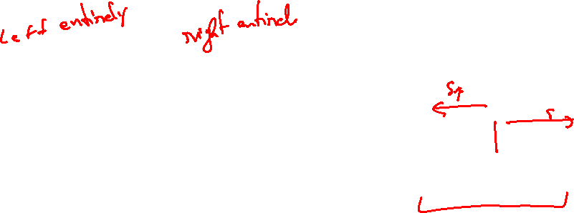

Slide 3
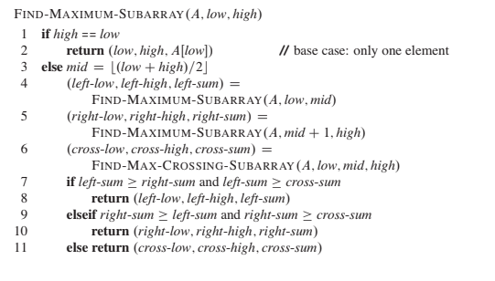




Slide 4
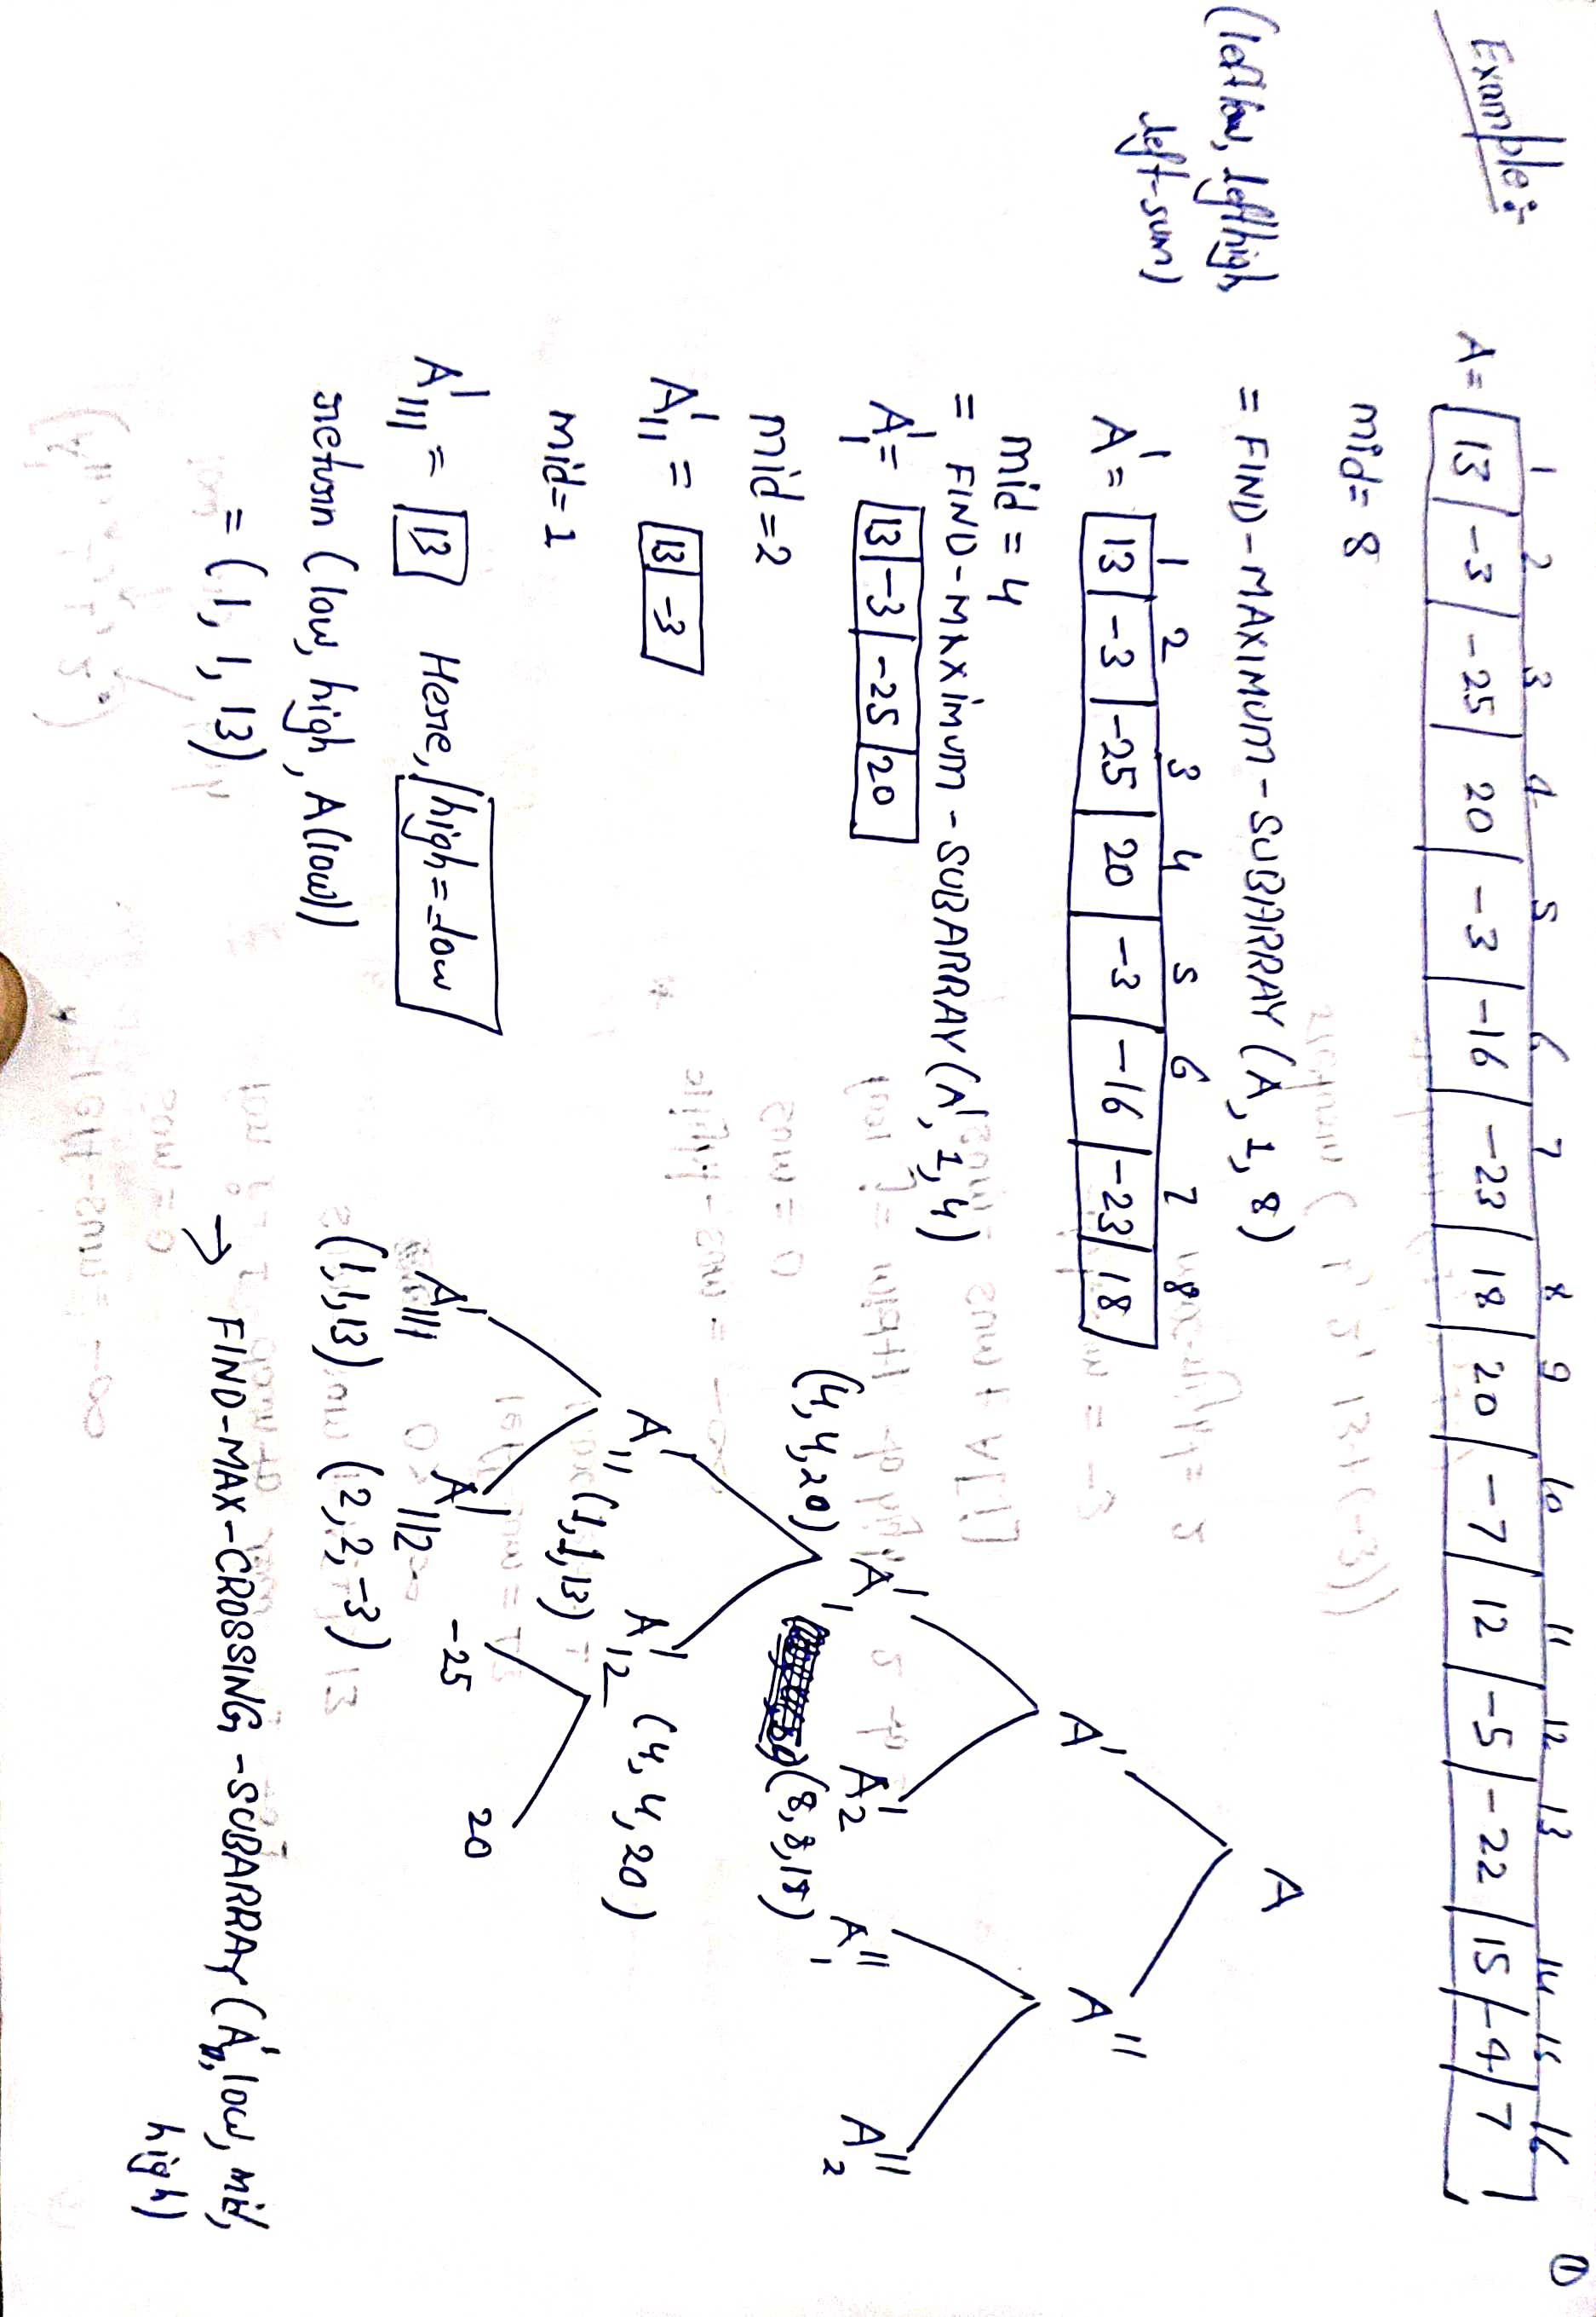
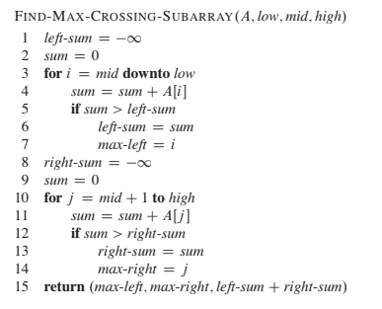

Slide 5
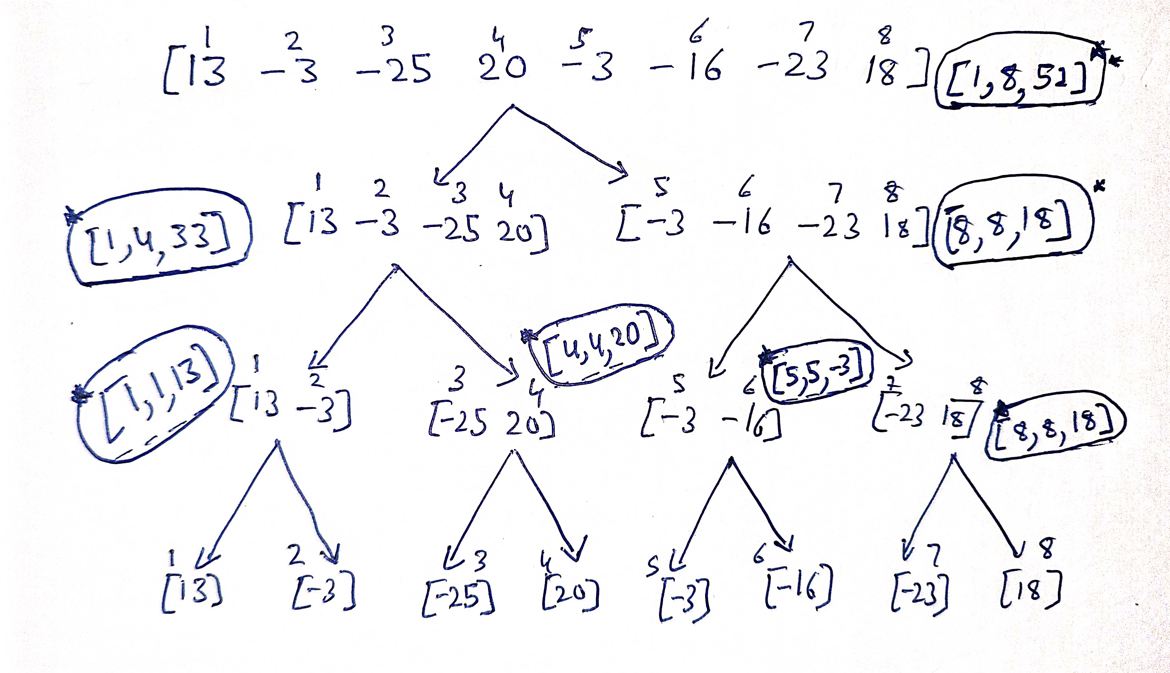

Slide 6
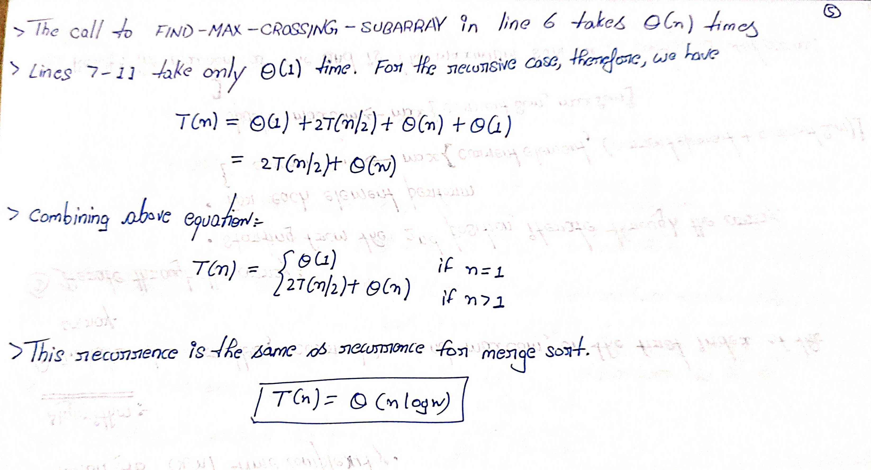


Slide 7
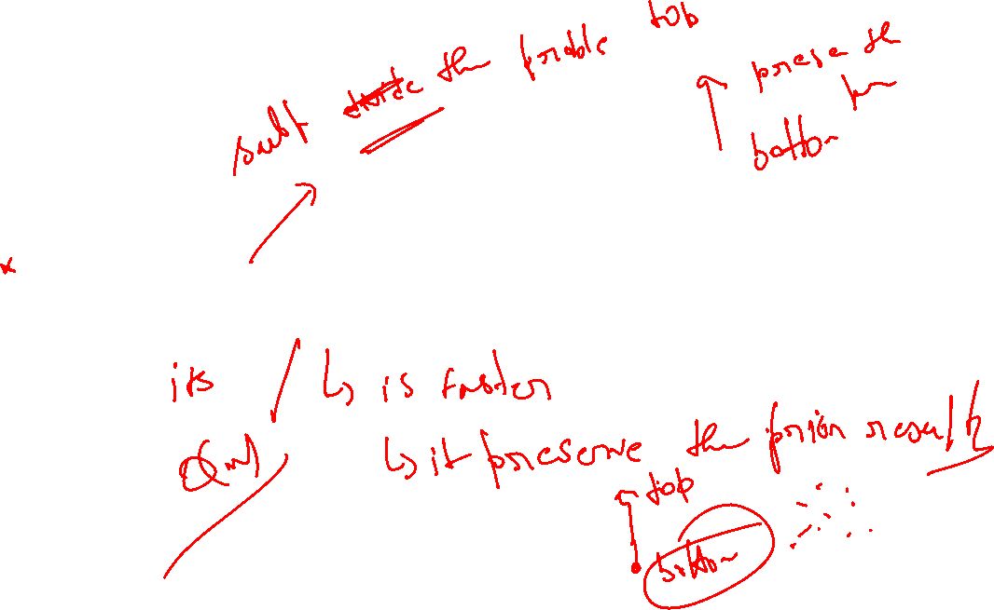
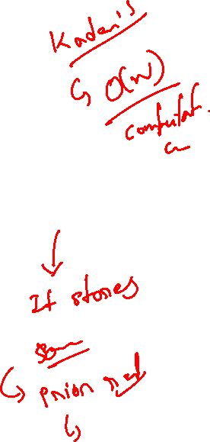
Dynamic programming algorithm

Slide 8
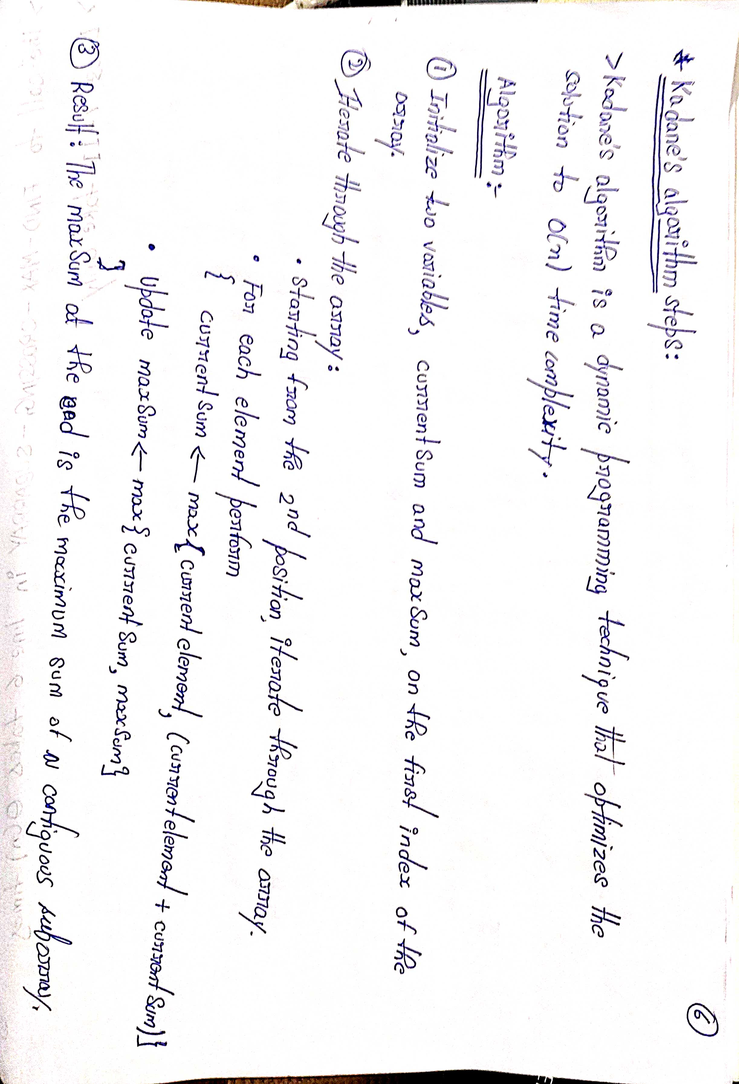
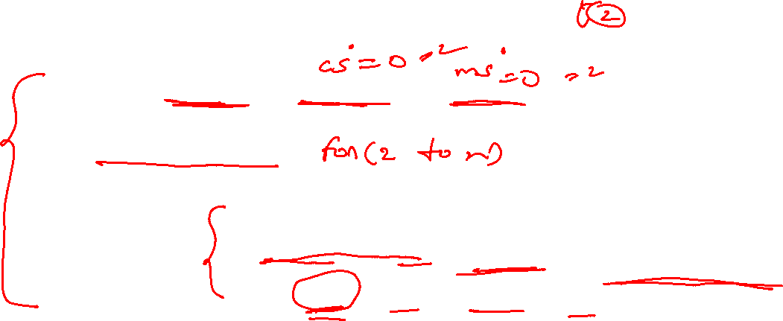

Slide 9
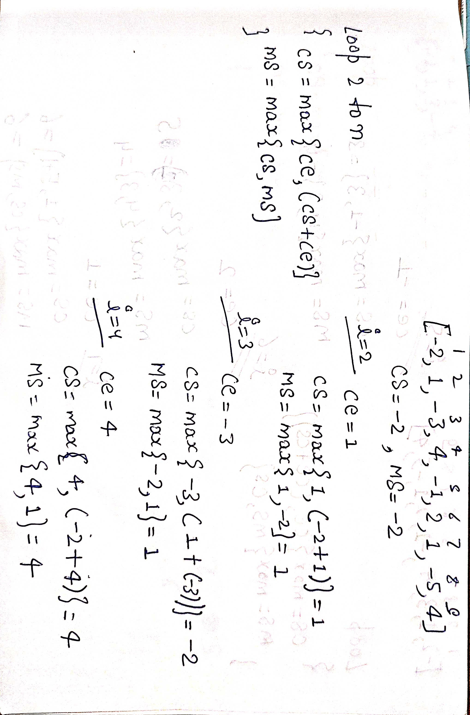
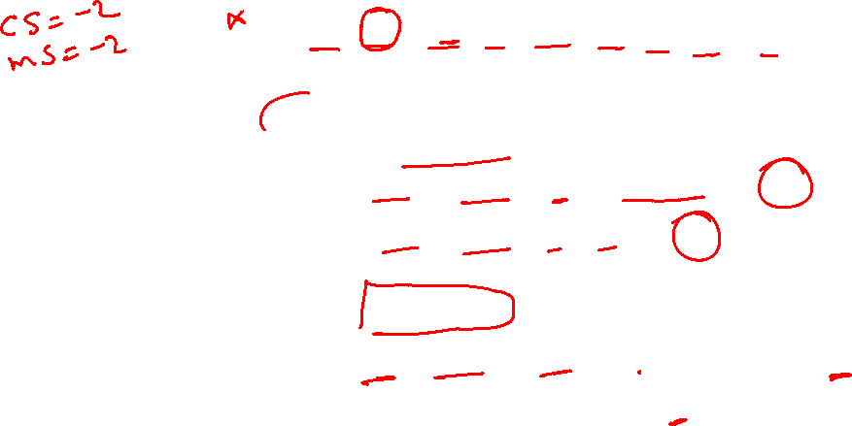

Slide 10
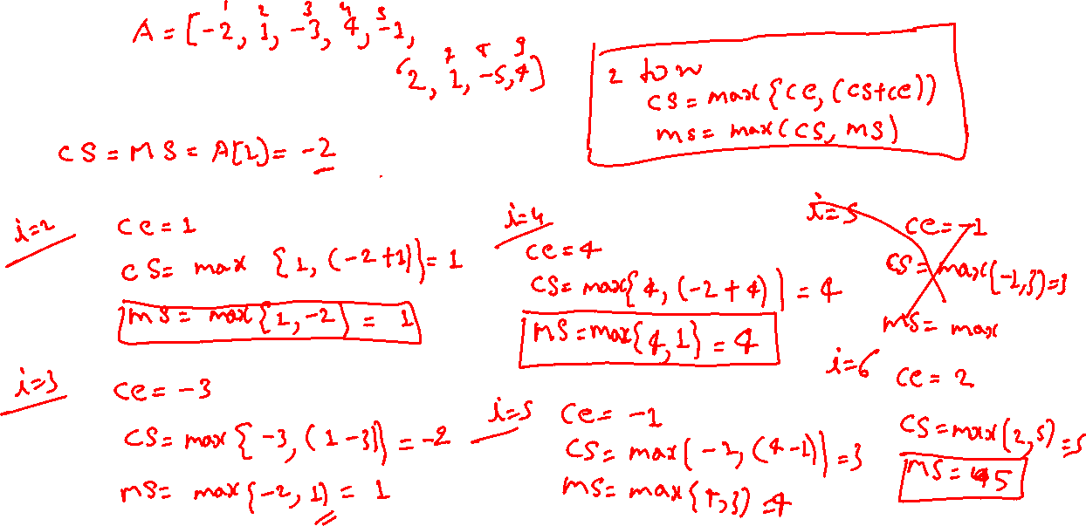





Slide 11

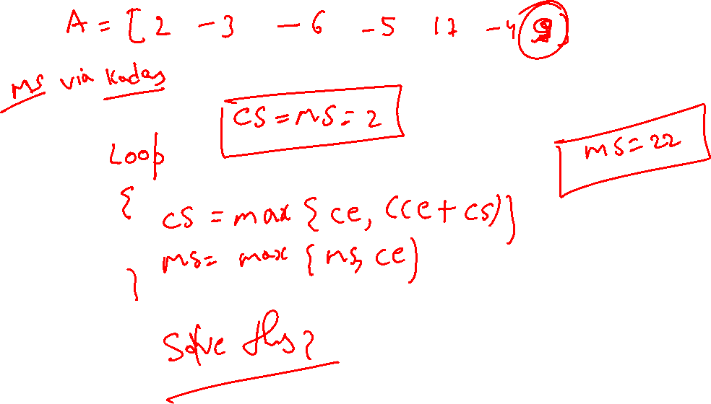

Slide 12
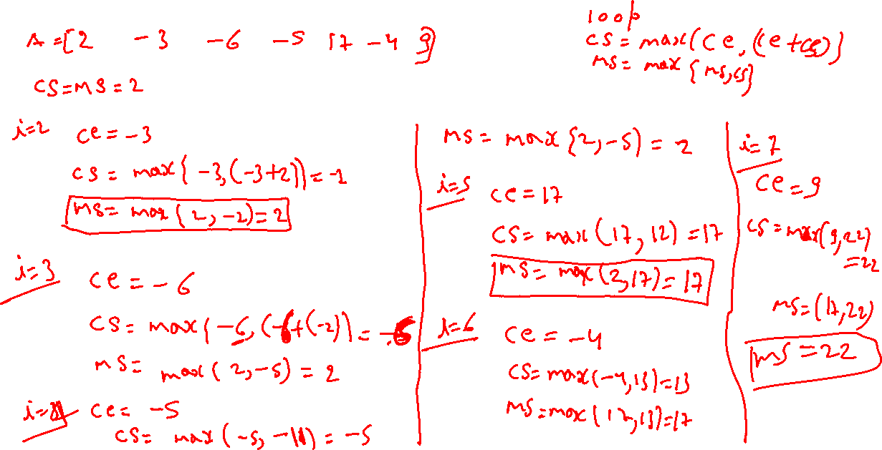




Slide 13
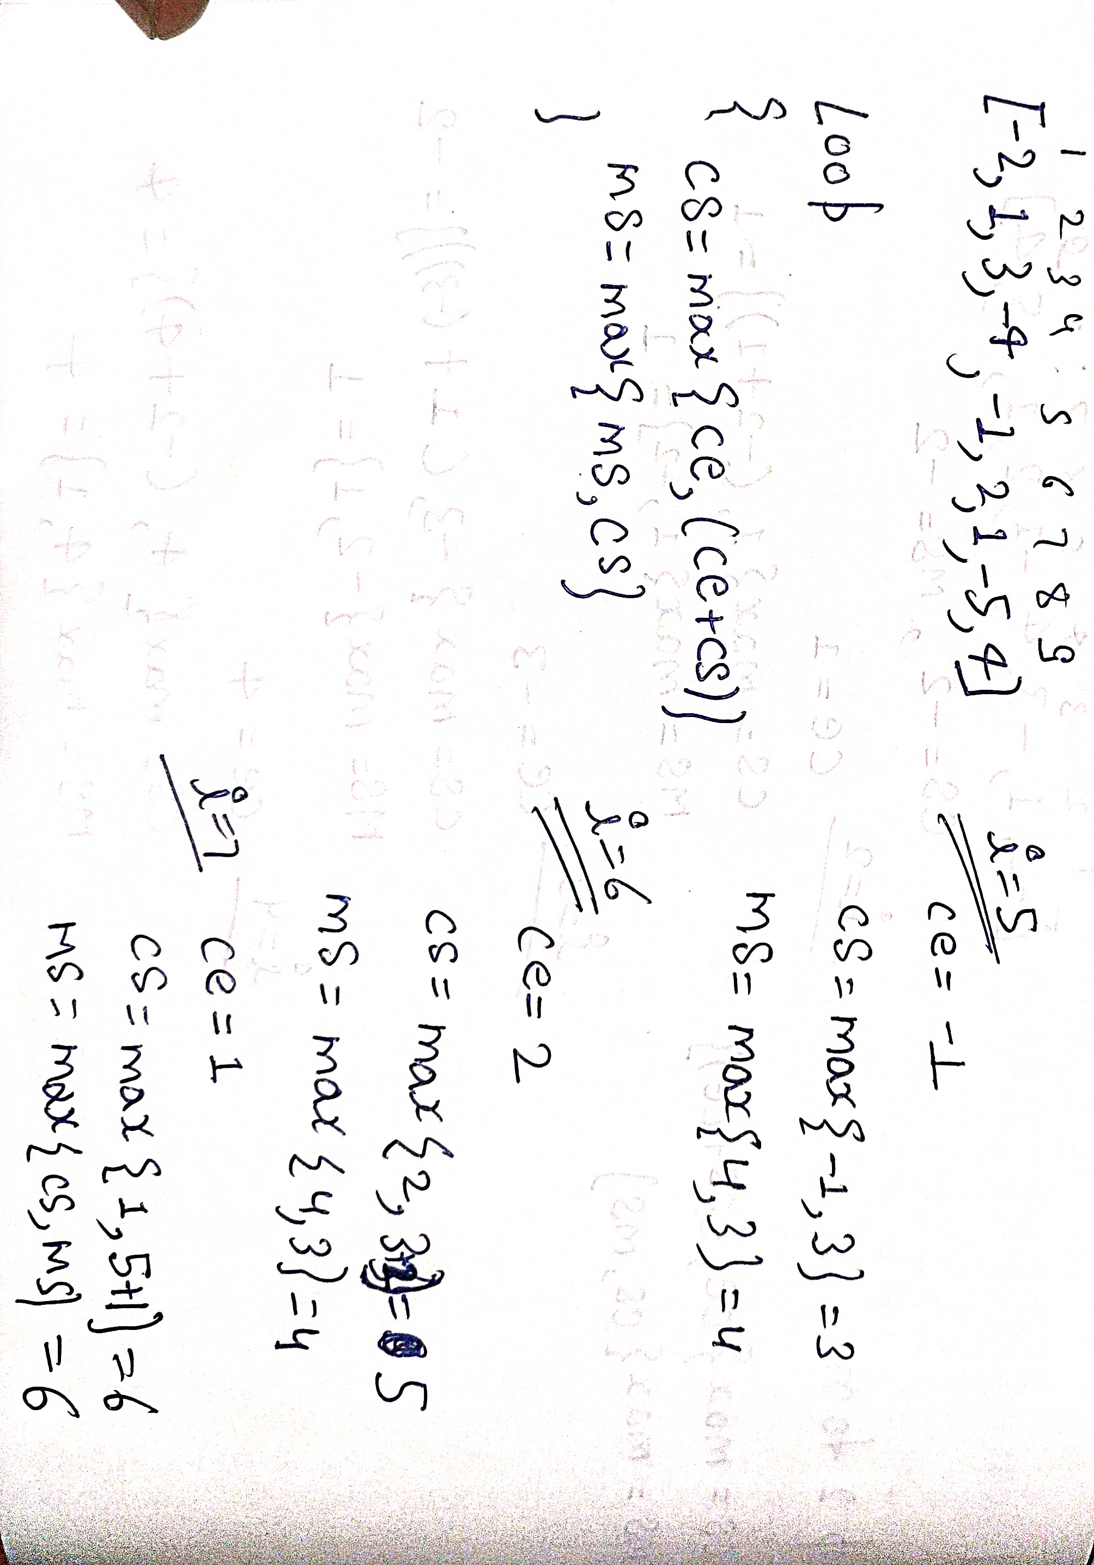


Slide 14
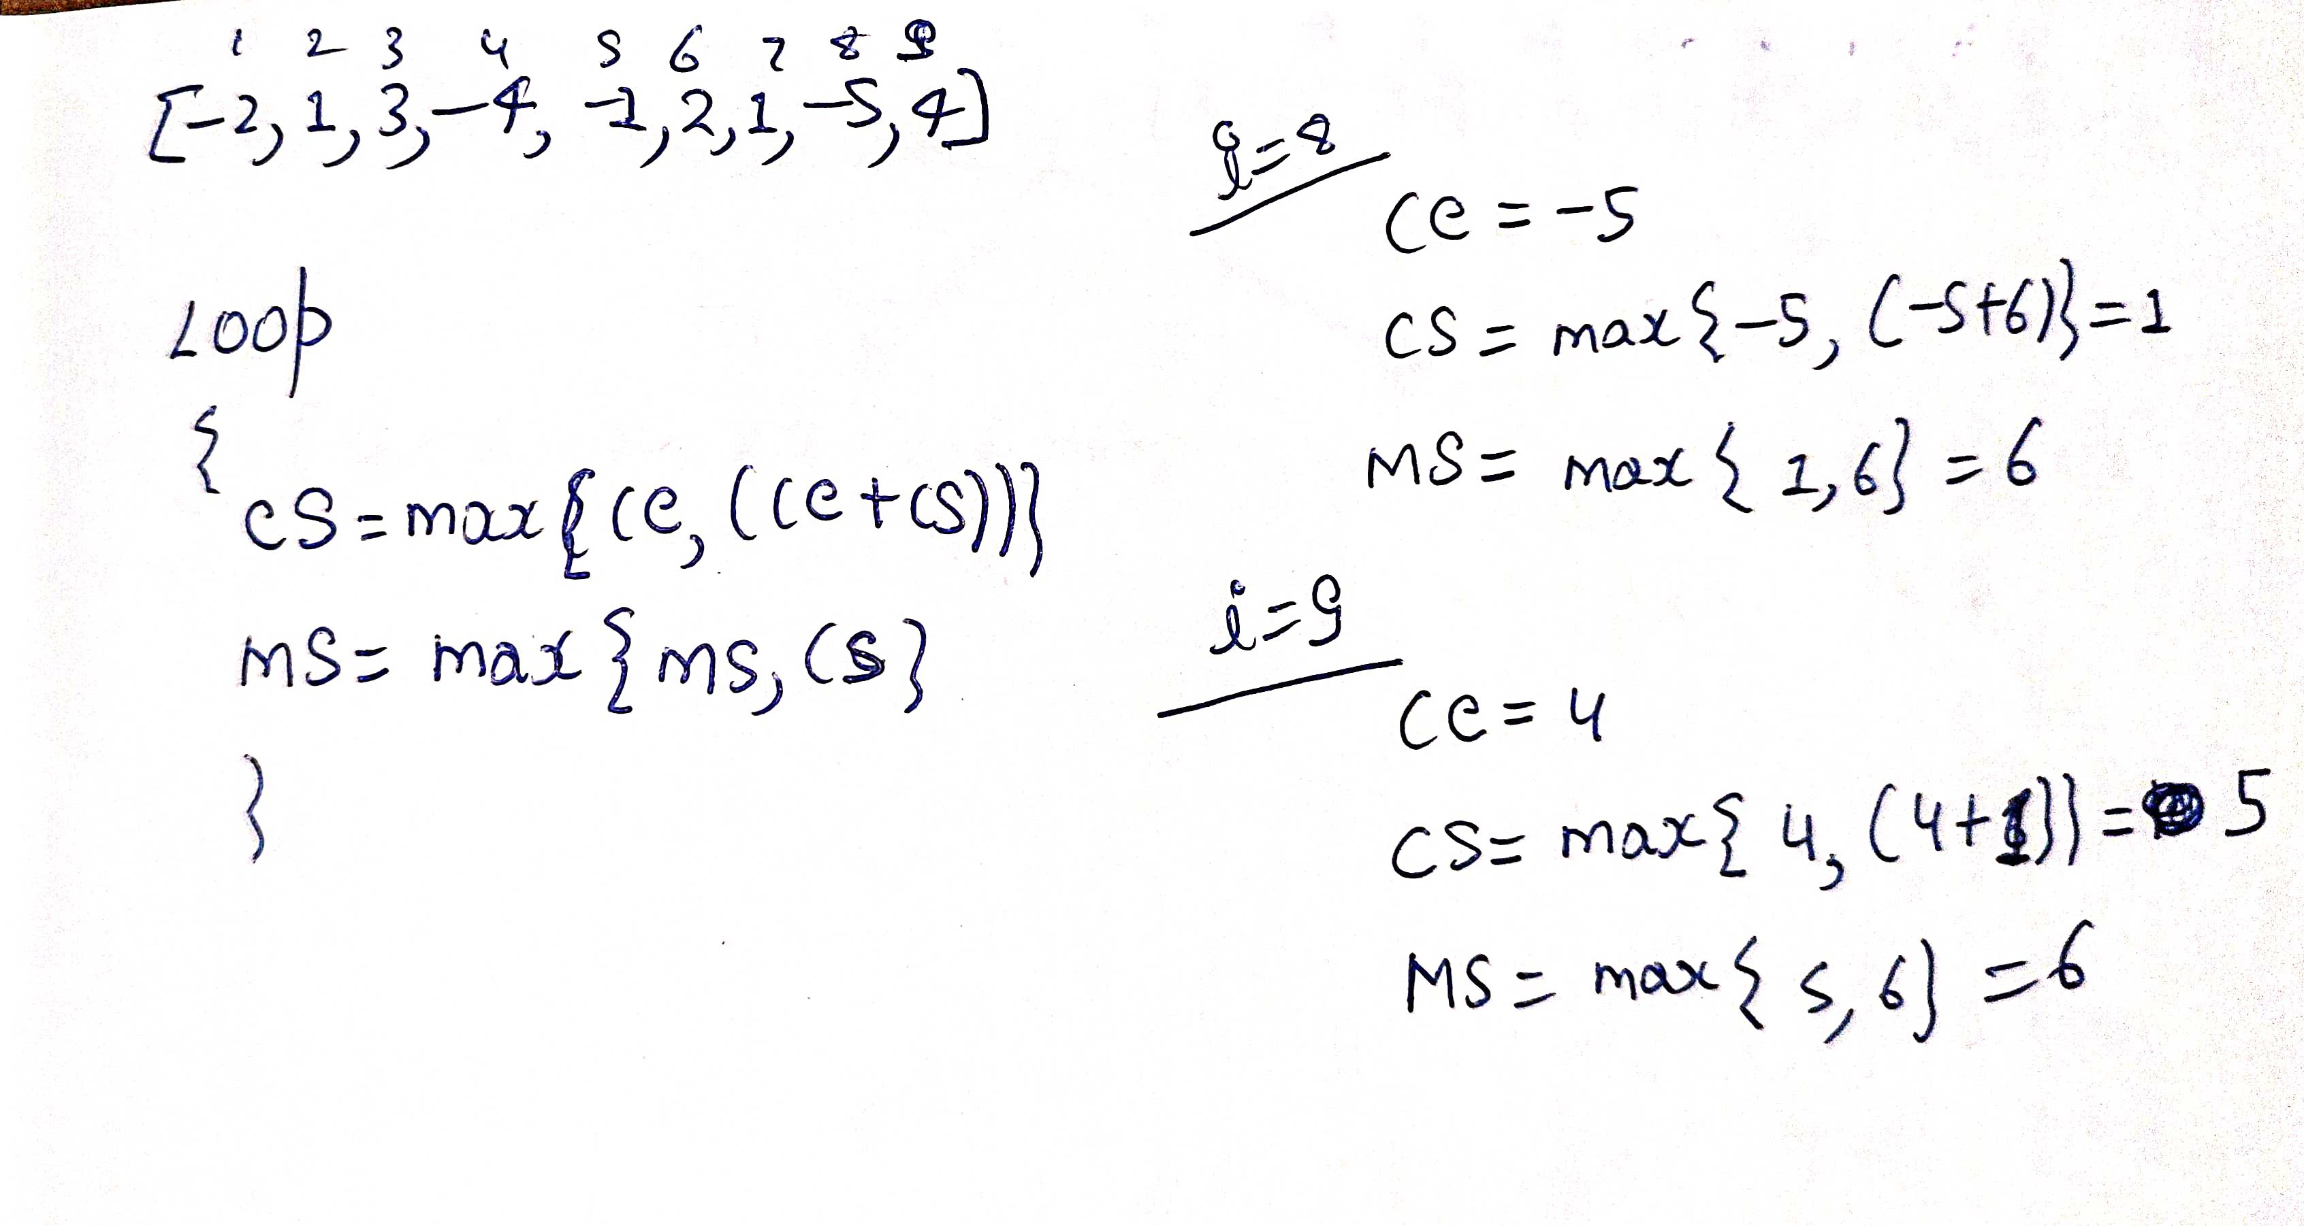


Slide 15



















Slide 16
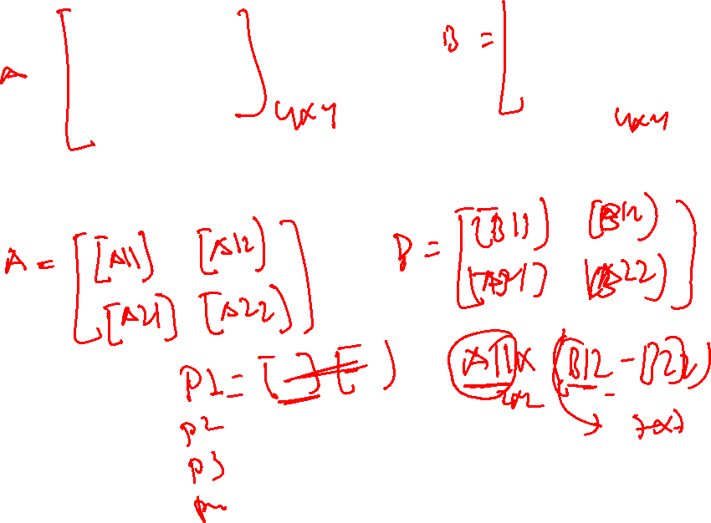

Slide 17
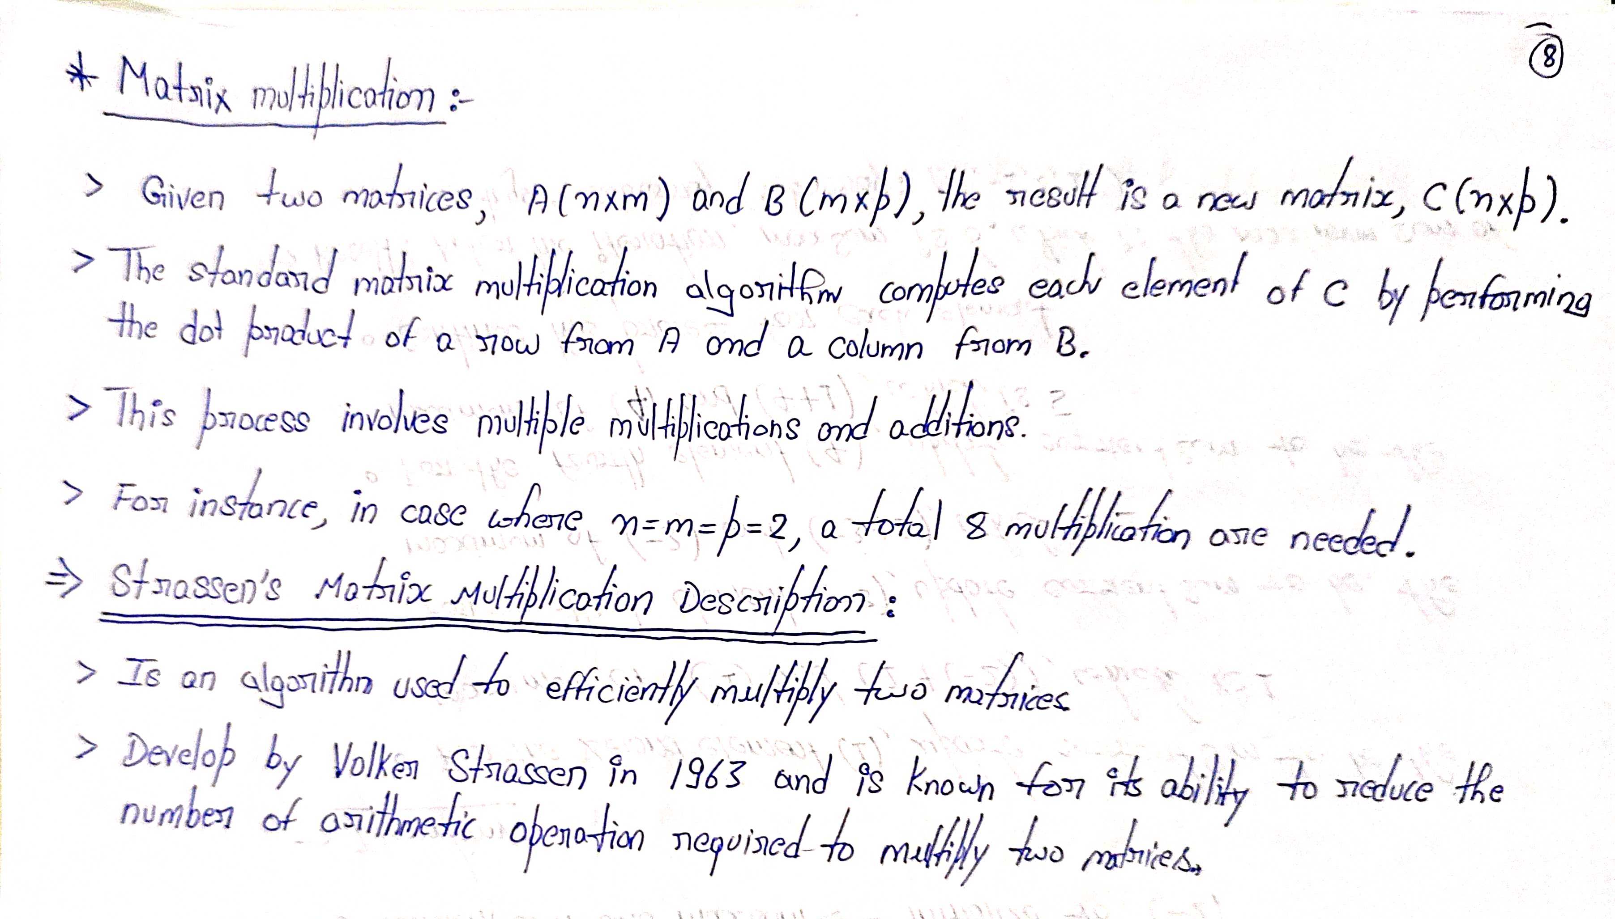

Slide 18
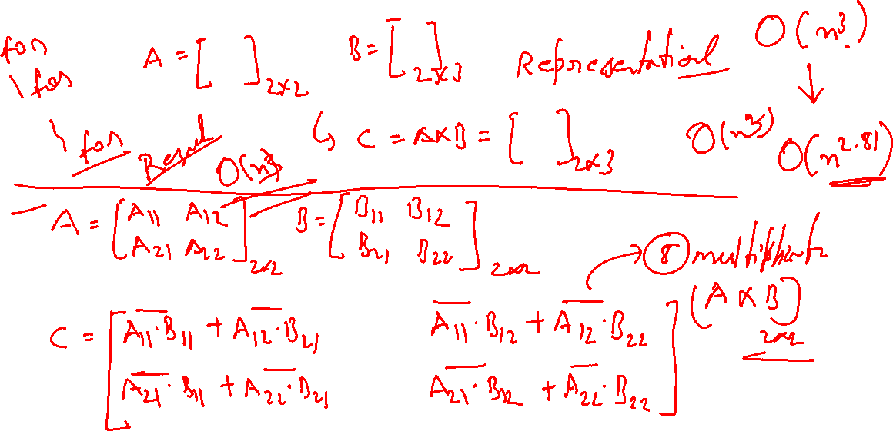

Slide 19

Basic Matrix Multiplication
void matrix_mult (){
for (i = 1; i <= N; i++) {
for (j = 1; j <= N; j++) { compute C_{i,j}; }
}}
algorithm
Time analysis

Slide 20
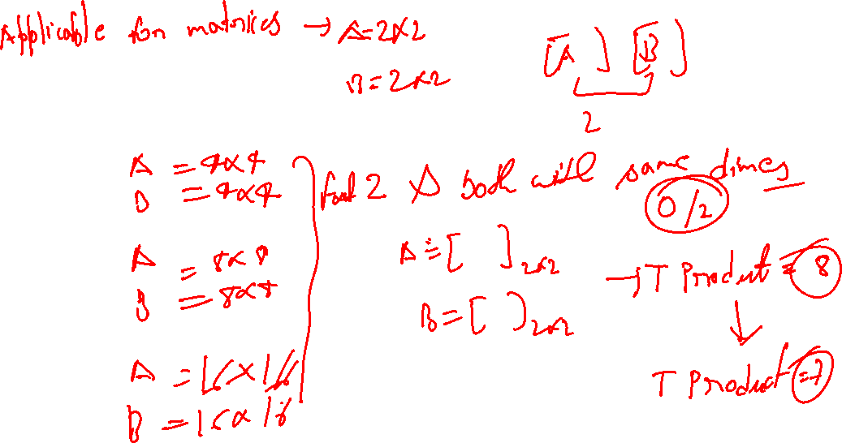


Slide 21
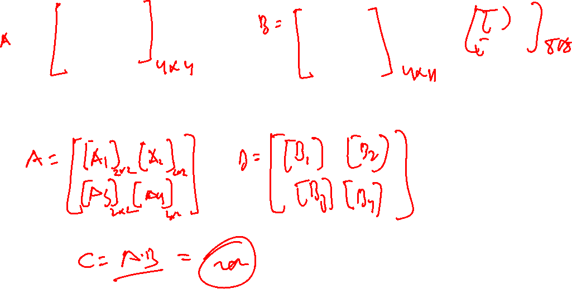

Slide 22
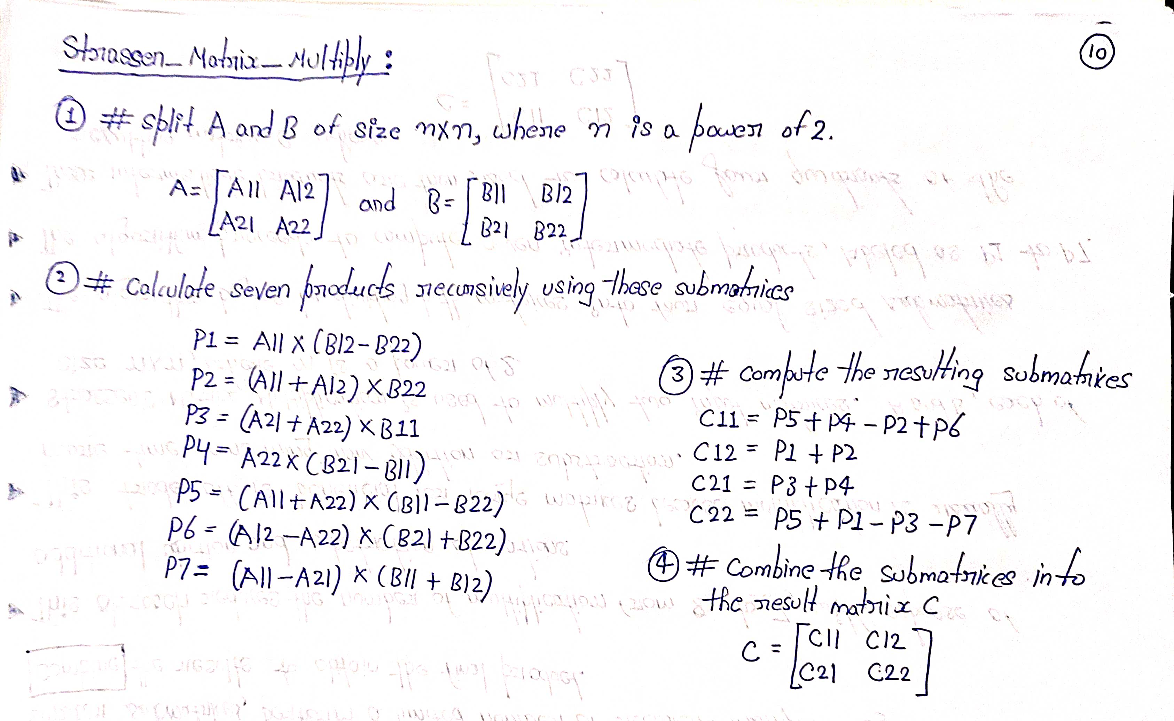

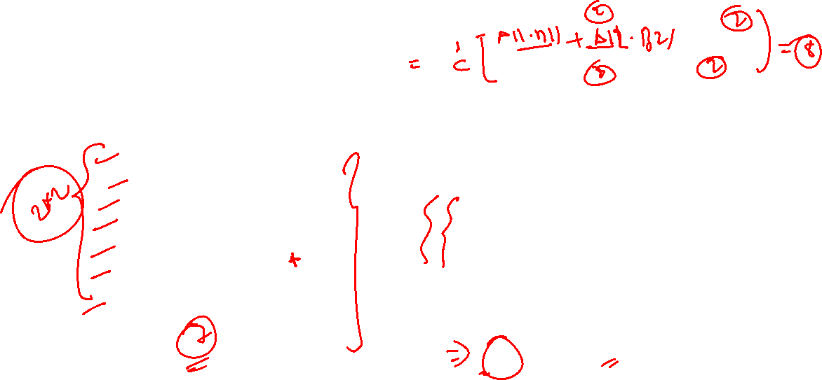

Slide 23
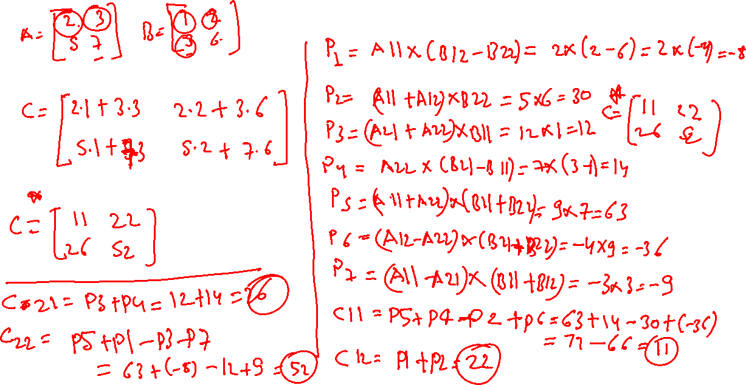

Slide 25
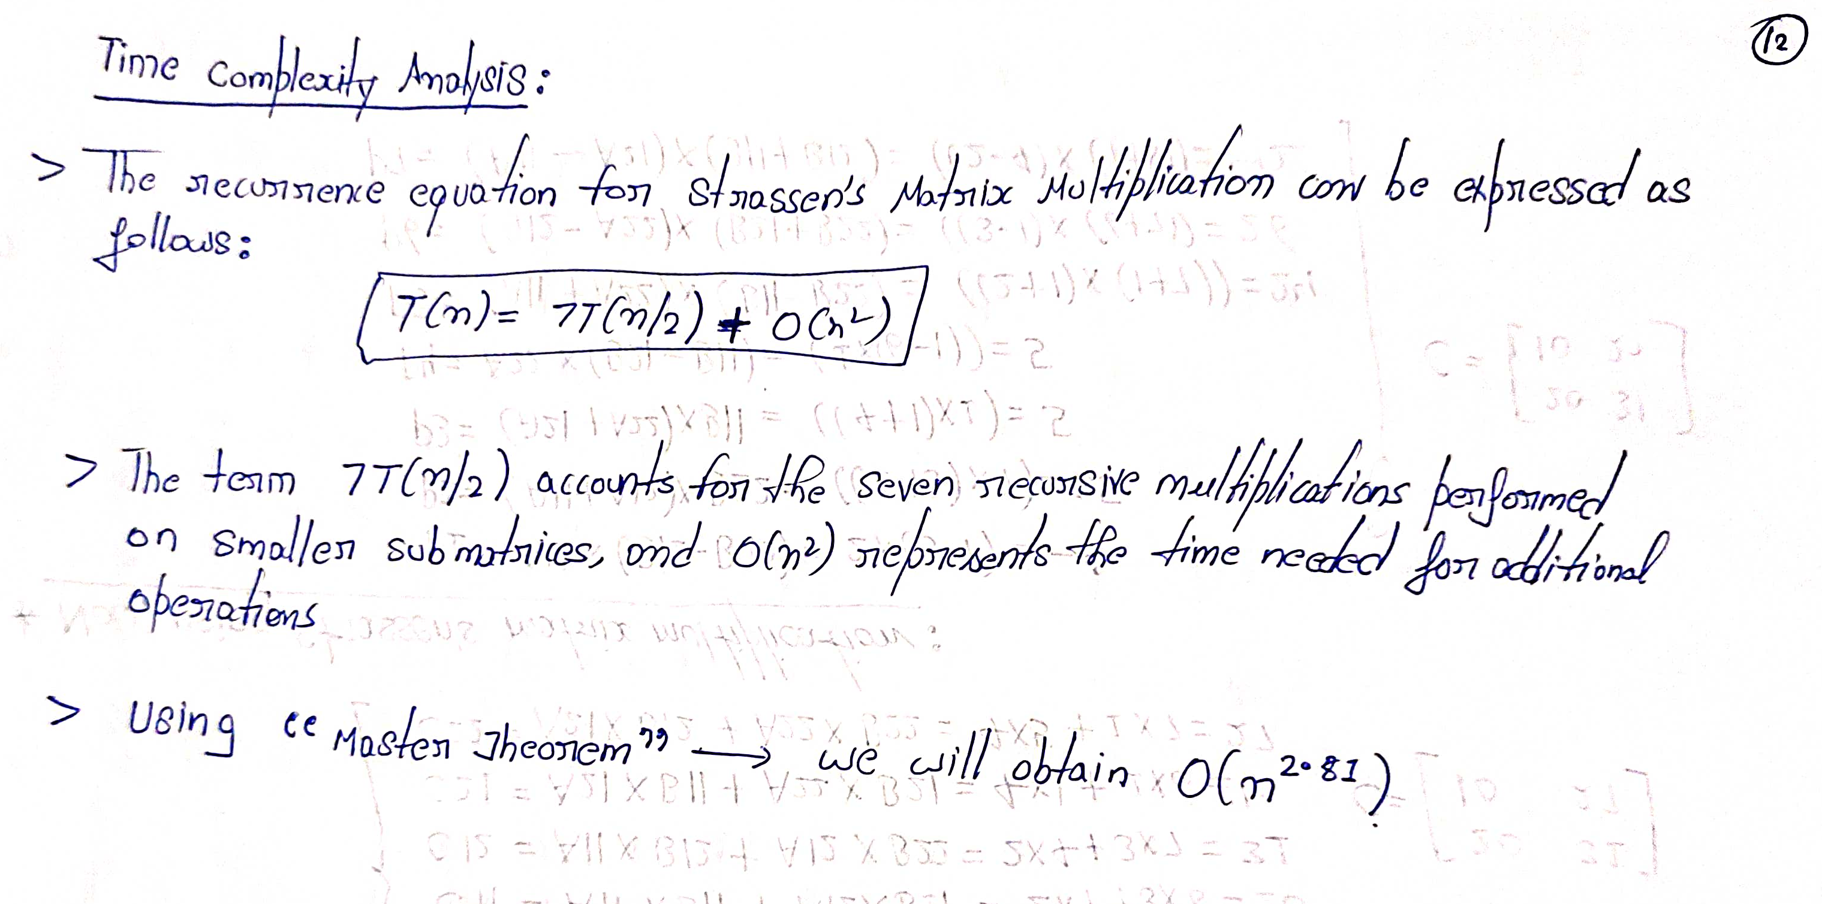
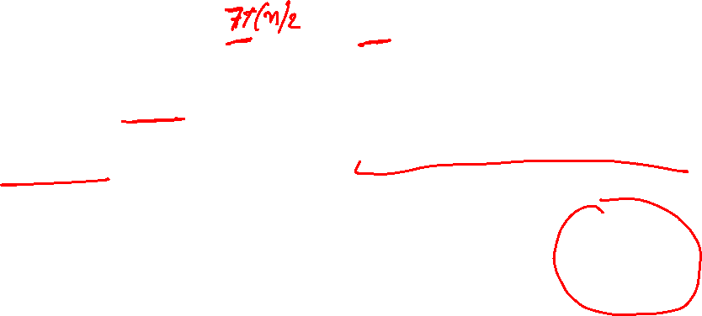

Slide 26
Closest pair problem
The Closest pair problem is a fundamental computational challenge that revolves around the task of identifying the pair of points with the smallest distance between them within a given collection of N points.
This problem finds relevance and application across various domains, from computational geometry to pattern recognition and beyond. The choice of the most suitable algorithm to tackle this problem depends on two crucial factors: the specific value of N, representing the number of points in the set, and the desired outcome, which could involve finding the actual distance, the point coordinates, or both.
As we navigate through this problem, we encounter a spectrum of scenarios and computational intricacies, all of which stem from the variable N and the specific requirements of the task at hand. The larger the N, the more complex the problem becomes, and the choice of algorithm becomes critical to achieve efficient solutions.

Slide 27
In the realm of brute-force approaches, it is evident that the Closest Pair Problem can be solved in O(N2) time.
This section delves into the intricacies of a divide-and-conquer-based algorithm that has been specifically crafted to address the Closest Pair Problem in a more efficient and effective manner.
This algorithm optimizes the search for the closest pair of points, significantly reducing the time complexity, especially when N is substantial.

Slide 28
Divide-and-conquer algorithm for solving closest pair problem:
The central concept involves divide-and-conquer based algorithms for solving closest pair problems by dividing the set of points in half and recursively searching for the closest pair of points within each half.
To comprehend the solution approach more thoroughly, we'll explore it from three different perspectives: the 1-dimensional (1D), 2-dimensional (2D), and d-dimensional (dD) closest pair problem.

Slide 29
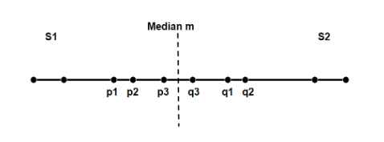
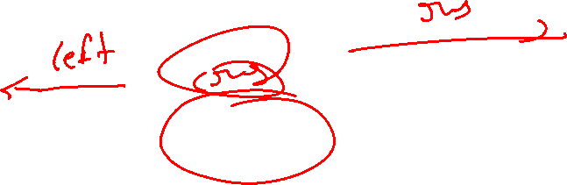

Slide 31
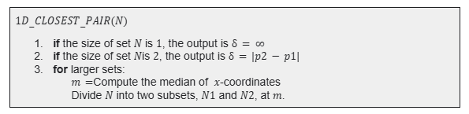
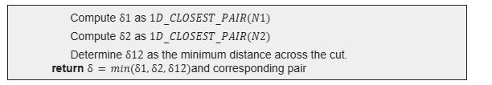

Slide 32
The recurrence equation for the 1D closest pair problem can be expressed as follows T(n)=2T(n/2)+O(n).
In this relationship, T(n) denotes the time required to solve the 1D closest pair problem for a set of n points.
The term 2T(n/2) accounts for the two recursive closest pair computations performed on smaller subproblems.

Slide 33
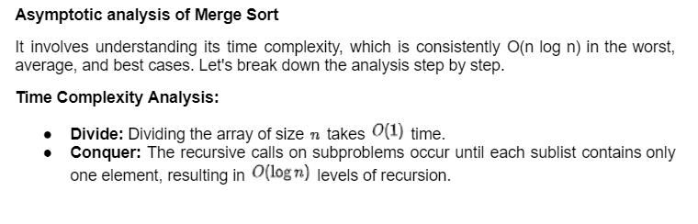
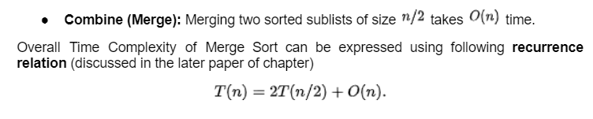

Slide 34
Binary Search
Binary search operates by iteratively dividing the search range in half, progressively narrowing down the possibilities at each step.
We can denote the time taken for a dataset of size 'n' as T(n), where T(n/2) accounts for the time spent searching within one-half of the dataset, and O(1) represents the constant time required for comparisons and calculations.
This can be expressed using the recurrence relation:
T(n)=T(n/2)+O(1)

Slide 36
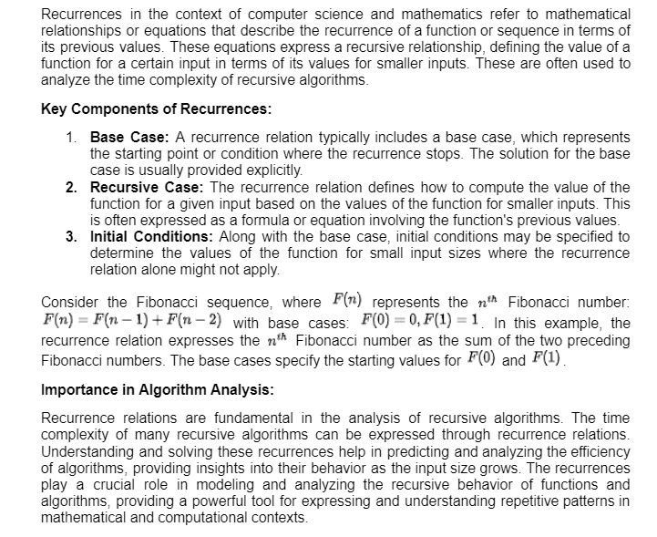
Recurrences

Slide 37
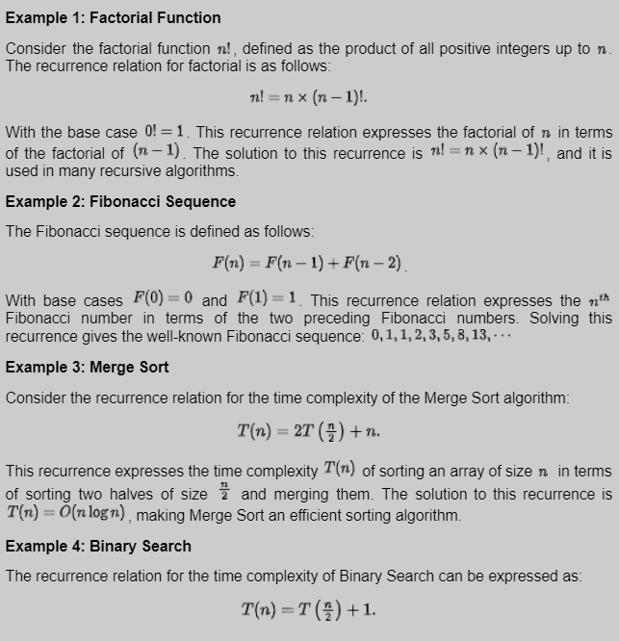
Recurrences

Slide 38
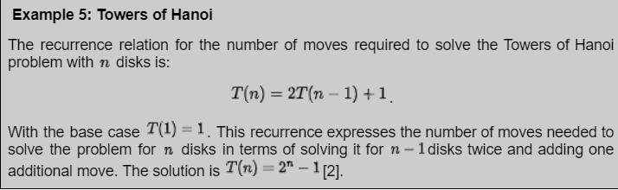
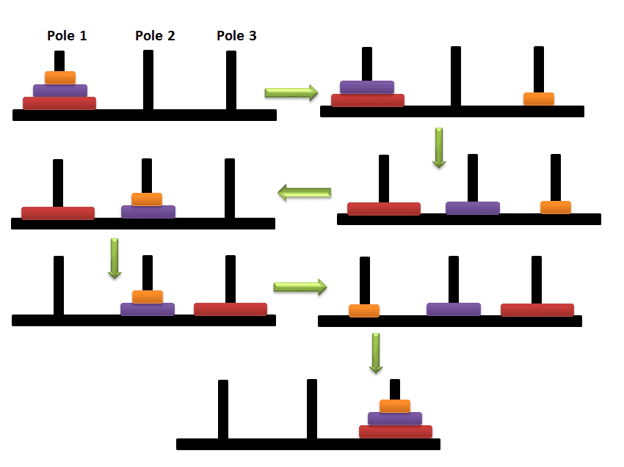
Recurrences
Detailed in Stack Chapter

Slide 39
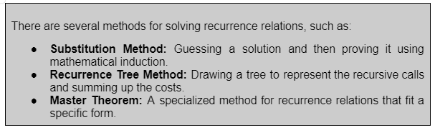
Recurrences

Slide 40
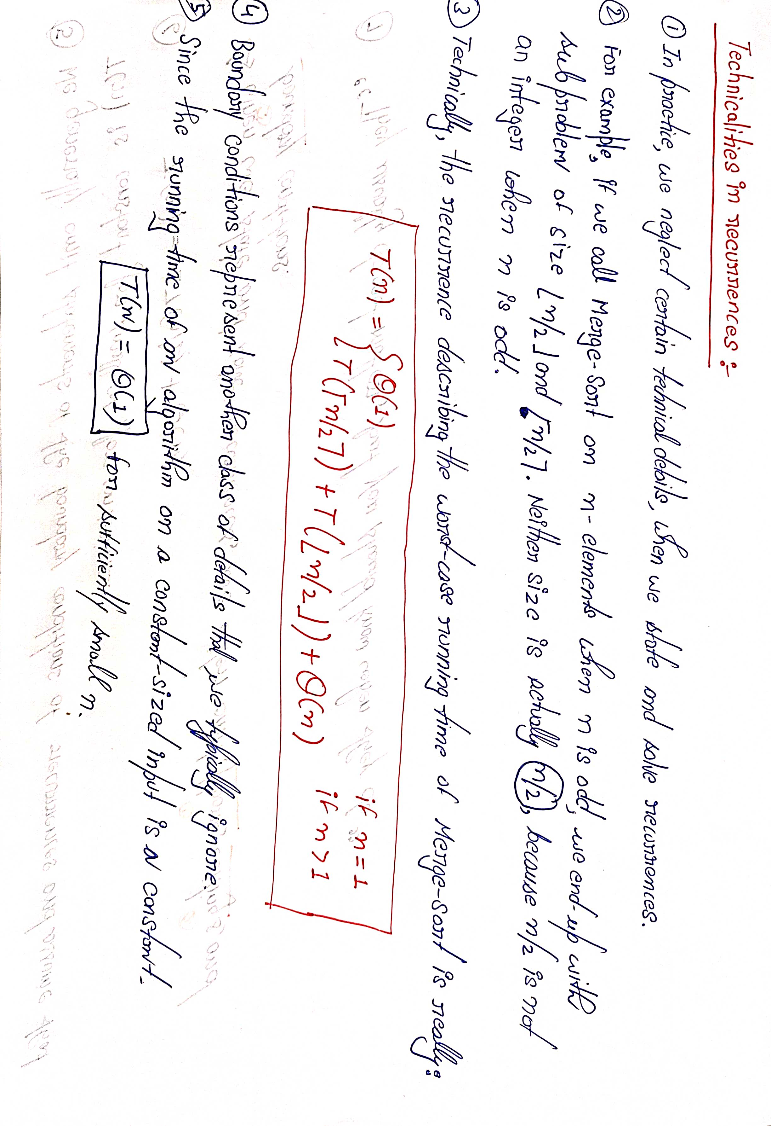

Slide 41
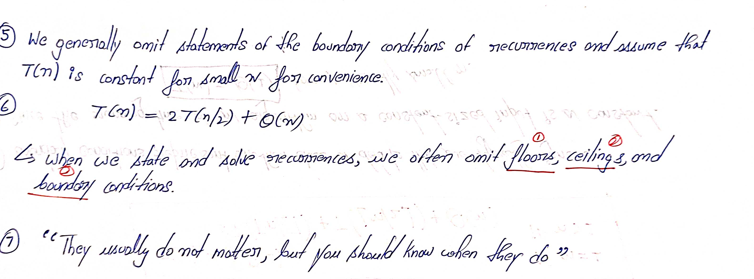

Slide 42
Master Theorem
The master method is a formula for solving recurrence relations of the form:
T(n) = aT(n/b) + f(n),
where, n = size of input
a = number of sub-problems in the recursion
n/b = size of each sub-problem.
All sub-problems are assumed to have the same size. f(n) = cost of the work done outside the recursive
call, which includes the cost of dividing the problem and the cost of merging the solutions
Here, a ≥ 1 and b > 1 are constants, and f(n) is an asymptotically positive function.
An asymptotically positive function means that for a sufficiently large value of n, we have f(n) > 0.

Slide 43
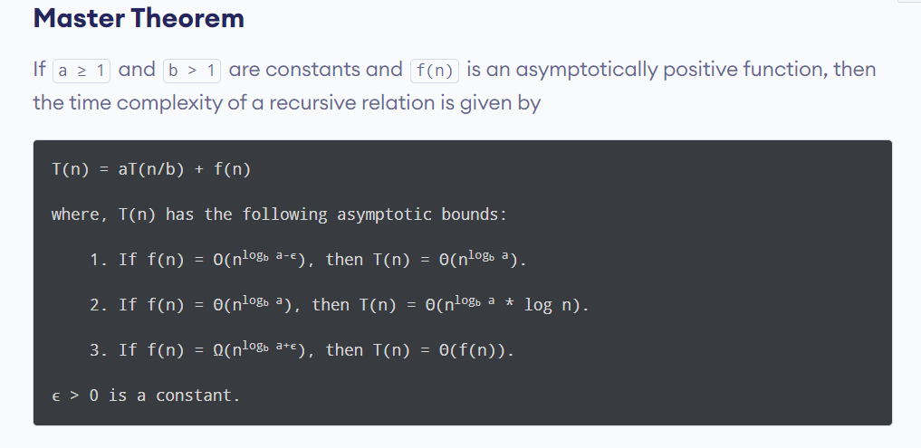
Master Theorem

